Slide 1
Our Prep
Before travel
Have a fallback for WiFi outage
Download these slides as PDF
Clone repo with latest version of https://colab.research.google.com/github/DJCordhose/practical-llm
On Site
Figure out speaker WiFi
Show prerequisites as first slide before beginning of workshop

Slide 2
Prerequisites - Running LLMs on Prem
Create a Google Account (if you do not have one, yet): https://accounts.google.com/
Login with that account into Google Colab: https://colab.research.google.com/
Create a Huggingface account (if you do not have one, yet): https://huggingface.co/join
Create an access token and save it for later use in the notebooks:
https://huggingface.co/settings/tokens
Request access to gated Huggingface models:
https://huggingface.co/meta-llama/Meta-Llama-3.1-8B-Instruct
https://huggingface.co/google/gemma-2-2b-it
Make sure you can open the workshop notebooks in Colab:
https:// colab.research.google.com/github/DJCordhose/practical-llm

Slide 3
Running LLMs on prem
A Practical Guide

Slide 4
Why self hosting an LLM?
You might want control over
Privacy / data protection
Availability and Scaling
Latency
Limitations
Cost of operation
Ecological footprint
Stability

Slide 5
Architecture Decision: self-hosting ?
Decision : yes
Key-Driver : privacy, version stability, limitations
Challenge : which LLM ? Does it run on your hardware ?
Surprises : operating GPUs is really hard
Failures
Power
Stability
Complexity, Work, Troubles

Slide 6
This workshop is about solving the challenges arising from self hosting

Slide 7
Who are we?
Olliver Christian

Slide 8
LLM Intro

Slide 9

Transformers, LLMs, Encoder, Decoder: WTF?
Transformers: A flexible architecture that uses self-attention to process sequential data efficiently.
LLMs: Large-scale Transformer models trained on extensive text datasets to perform various language tasks.
Encoder Models:
Part of the Transformer architecture focused on understanding and interpreting input data (e.g. BERT)
Instrumental for Embedding Models
Decoder Models:
Part of the Transformer architecture focused on generating sequential output based on the interpreted inputs or prior outputs
Instrumental for GPT-style Models like Llama, Mistral or OpenAI GPT

Slide 10
Decoder Models

Slide 11

How does a Decoder Model work ?
Q: what is pluvia ?
[312, 2,17,…]
Depends on users goal
Unique for each chat & user
Contains the chat history
«the context»
Trained on huge datasets
Does not change
Same for all users
«the model»
Notes:
To bring everyone on the same page here’s a short high-level overview of how decoder models work:
We are given the users input in the form of a string, here the question «what is pluvia»
This string is called «the context»
The context may also contain additioinal instructions for the model, like «answer in french» or «in the style of a medievial aristocrat».
The context string is converted into a sequence of integers. How this is done, we will see in a minute.
The sequence is then processed by the model, yielding an initial hidden state.
Using the hidden state the model generates an output vector containing scores.
Based on these scores the first word of our answer is chosen.
How this selection works in detail, we will also see in a minute.
These words are also called tokens.
To be more prcise: a token is either a word or a word fragment.
For example the word «swimming» contains the 2 tokens «swim» and «ming».
We take our first take and feed it back into the model. Which uses it to update ist hidden state.
The token is also added as the first word to our answer.
The model now – using ist updated hidden state – generates the second output vector.
And again based on ist scores the next token is chosen.
And so on.
Gpt 3 and 4 only need about 50000 tokens to represent an arbitrary string.
Since this is a finite number, we can easily assign to each token a unique id, namely a number between 1 and 50000.
Using these ids we can now easily represent any string as a sequence
And thats how the context was converted into a list of integers at the very beginning.
Since each token has an id – a number between 1 – 50000 – we can use it as an index into the ouput vector.
Thereby assigning to each token a score.
Of course the vectors must have a suitable size, namely 50000.
For example the token with id 3 gets a score of 98 and the one with id 4 -23.
To select the output token, we prefer tokens with a high score.
Thus token with id 3 is much likelier to win then the one with id 3.
More precisely: we convert the output vector to a probability distribution over the token ids using a so-called softmac function.
We then sample from this distribution to get the output token.
There is a common hyperparameter for models called temperature. The temperature simply modifies the distribution.
A high temperture assigns the tokens with a low score a higher probability. Thus the model is likelier to return an «unexpected» or
«surprising» token. Marketing calls this «making the model more creative».
While a low temperature assigns the tokens with a low score even a lower score. Making the selection more deterministic.
Like this we continue until we eventually get an eot or an end-of-text token. Which tells us to stop the generation.
And we end up with the final answer «pluvia is the latin word for rainfall».
These models tend to be really large, typically containing billions or even a trillion parameters.
This poses some particular challenges in bringing them to local hardware.

Slide 12
How does a Decoder Model work ?
A: Pluvia
Q: what is pluvia ?
-24
39
-398
91
…
Pluvia
[312, 2,17,…]
Depends on users goal
Unique for each chat & user
Contains the chat history
«the context»
Trained on huge datasets
Does not change
Same for all users
«the model»
Single «word»
Depends on context and model
«the token»

Slide 13
How does a Decoder Model work ?
Q: what is pluvia ?
A: Pluvia
3.1
14.1
45.9
-7
…
is
[312, 2,17,…]
Depends on users goal
Unique for each chat & user
Contains the chat history
«the context»
Trained on huge datasets
Does not change
Same for all users
«the model»
Single «word»
Depends on context and model
«the token»

Slide 14
How does a Decoder Model work ?
Q: what is pluvia ?
A: Pluvia is
2.78
0.02
98.7
-23
…
a
[312, 2,17,…]
Depends on users goal
Unique for each chat & user
Contains the chat history
«the context»
Trained on huge datasets
Does not change
Same for all users
«the model»
Single «word»
Depends on context and model
«the token»
Represented as an int id

Slide 15
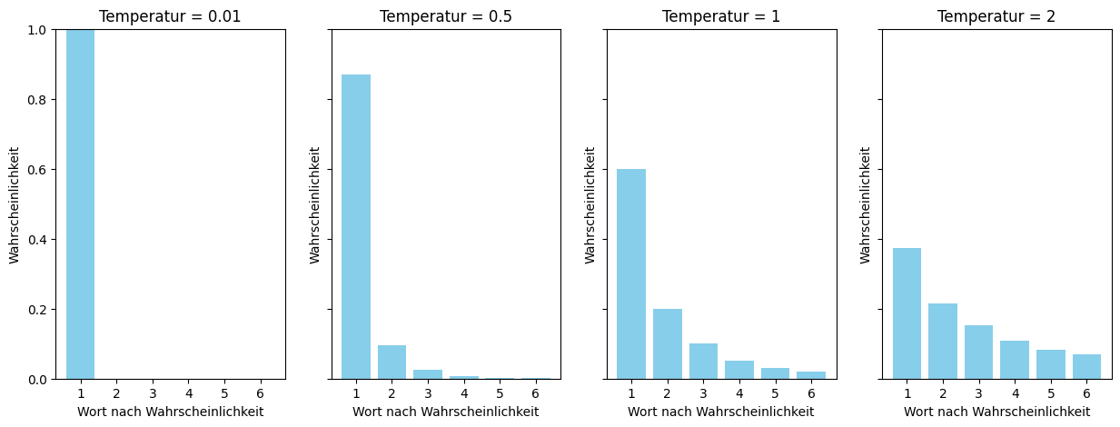
How does a Decoder Model work ?
Q: what is pluvia ?
A: Pluvia is a
2.78
0.02
98.7
-23
…
latin
[312, 2,17,…]
Depends on users goal
Unique for each chat & user
Contains the chat history
«the context»
A list of token ids
Trained on huge datasets
Does not change
Same for all users
«the model»
Output a probability distribution over token ids
Single «word»
Depends on context and model
«the token»
Represented as an int id

Slide 16
Q: what is pluvia ?
A: Pluvia is a latin
4
17.2
-33
0.01
…
…
[312, 2,17,…]
Depends on users goal
Unique for each chat & user
Contains the chat history
«the context»
A list of token ids
Trained on huge datasets
Does not change
Same for all users
«the model»
Output a probability distribution over token ids
Single «word»
Depends on context and model
«the token»
Represented as an int id

Slide 17
How does a Decoder Model work ?
Q: what is pluvia ?
A: Pluvia is a latin word meaning rainfall.
0.2
29.4
95
567
…
EOT
[312, 2,17,…]
Depends on users goal
Unique for each chat & user
Contains the chat history
«the context»
A list of token ids
Trained on huge datasets
Does not change
Same for all users
«the model»
Output a probability distribution over token ids
Single «word»
Depends on context and model
«the token»
Represented as an int id

Slide 18
Decoder On-Prem Challenges
Context sizes vary (depending on the Model)
with large contexts certain positions might be blind spots
Memory consumption grows with context used
Response time grows with tokens produced
Inference on GPU only

Slide 19
Comparing suitable NVDIA GPUs
T4/RTX 20 : https://en.wikipedia.org/wiki/Turing_(microarchitecture)
V100 - professional variant of RTX 20 consumer line: https://en.wikipedia.org/wiki/Volta_(microarchitecture)
A100/RTX 30 : https://en.wikipedia.org/wiki/Ampere_(microarchitecture)
L4/L40/RTX 40 : https://en.wikipedia.org/wiki/Ada_Lovelace_(microarchitecture)
H100 - professional variant of RTX 40 consumer line: https://en.wikipedia.org/wiki/Hopper_(microarchitecture)
Commodity: available for small money

Slide 20
Architecture Decision: What can we work with?
Limiting factor is GPU RAM
T4 : 16GB
A100 : 40GB/80GB
L4 : 24GB (L40: 48GB)

Slide 21
Limiting factor is GPU RAM: Quantization
Typical resolution is 16 Bit
Each parameter takes 2 Bytes
Transient memory and storage of context comes on top
Varies with
length of context
architecture of model
What about reducing resolution to 8 Bit or 4 Bit (and even 1 Bit)?
Thus cutting memory requirement down to half or quarter?
Overview: https://huggingface.co/docs/transformers/main/en/quantization/overview

Slide 22
Bitsandbytes: Most straight forward approach to quantization
https://huggingface.co/docs/text-generation-inference/conceptual/quantization#quantization-with-bitsandbytes
Deep Dive: https://huggingface.co/blog/hf-bitsandbytes-integration
Can go down to 4 Bits: https://huggingface.co/blog/4bit-transformers-bitsandbytes
inference can be slower than more sophisticated methods (like GPTQ) or full FP16 precision
https://huggingface.co/blog/hf-bitsandbytes-integration#is-it-faster-than-native-models

Slide 23
Architecture Decision: Smaller Model vs Quantiztion
Smaller Models
Key Driver multi language
Microsoft Phi 3.5 3.8B: https://huggingface.co/microsoft/Phi-3.5-mini-instruct
Google Gemma 2 2.6B: https://huggingface.co/google/gemma-2-2b-it
Quantization
https://huggingface.co/meta-llama/Meta-Llama-3.1-8B-Instruct
Quantized with bitsandbytes
to 4-Bit: https://huggingface.co/docs/transformers/main/en/quantization/bitsandbytes?bnb=4-bit
and 8-Bit: https://huggingface.co/docs/transformers/main/en/quantization/bitsandbytes?bnb=8-bit

Slide 24
Hands-On: Quantize Meta-Llama 3.1 8B
https://colab.research.google.com/github/DJCordhose/practical-llm/blob/main/Assessment.ipynb?hl=en

Slide 25
Local machine without NVIDIA GPU
llama.cpp
https://github.com/ggerganov/llama.cpp/blob/master/README.md
https://www.theregister.com/2024/07/14/quantization_llm_feature/
Quantization and optimization
Optimized for Apple Silicon M1/M2/M3/M4
Ollama
Simplifies usage of llama.cpp
https://ollama.com/
https://github.com/ollama/ollama
https://www.theregister.com/2024/03/17/ai_pc_local_llm/

Slide 26
60 Minuten

Slide 27
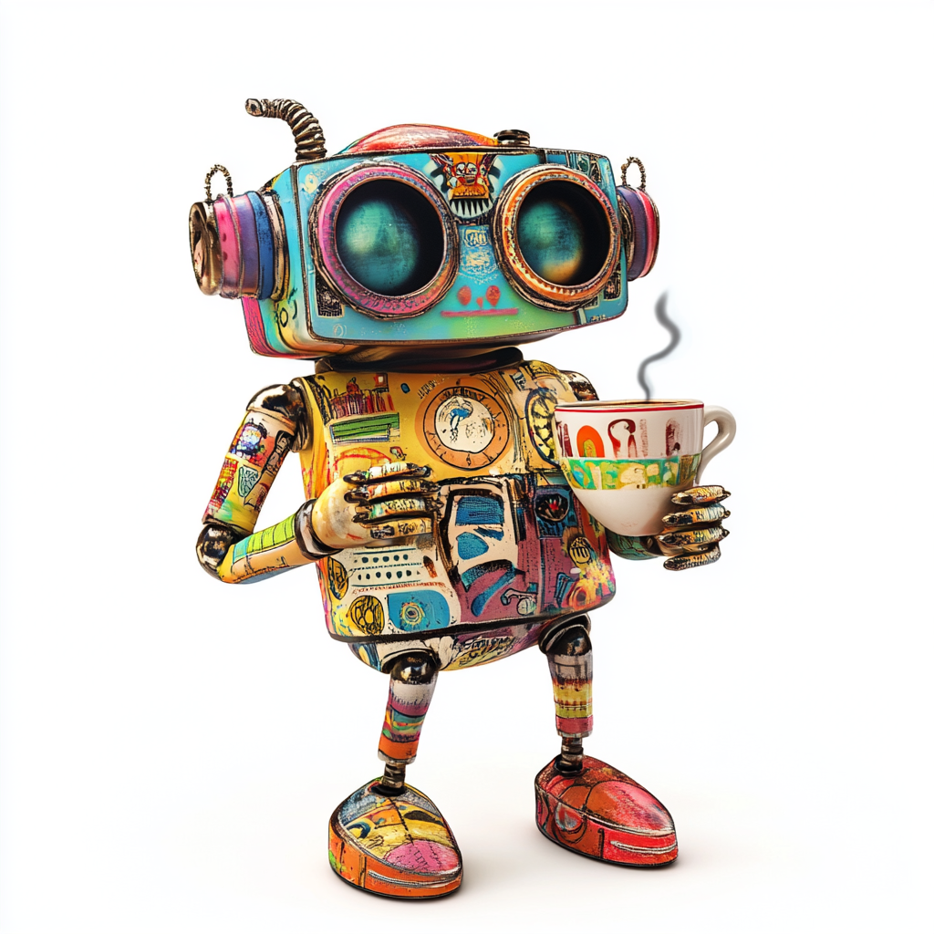
Coffee Break

Slide 28
Larger Decoder Models

Slide 29
Architecture Decision: Big Models on Heavy Hardware ?
There are more powerful versions of OS decoder models available
Rival OpenAI GPT 3.5
Support for major European languages
Quantized versions will run on small GPUs, but far too slow for real world
Useful as demonstration only
Those models will run on available hardware and dedicated inference server
H100 GPUs are are expensive, but available
Inference servers optimize for latency and throughput
https://huggingface.co/docs/text-generation-inference
https://developer.nvidia.com/nim
We can get a preview
https://build.nvidia.com/explore/discover
https://huggingface.co/chat/
The future is already here, it is just not evenly distributed
- William Gibbson

Slide 30
Option: Mixtral 8x7B
Good context length: 24K input, 8K output
explicitly tuned for European languages (like French, Italian, German and Spanish)
only uses fraction of parameters at a time
Reference
https://mistral.ai/news/mixtral-of-experts/
https://huggingface.co/mistralai/Mixtral-8x7B-Instruct-v0.1
Sparse Mixture of Experts (SMoE) Mixtral 8x7B: https://arxiv.org/abs/2401.04088

Slide 31
Option: Llama 3.1 70B
Even better context length: 128k
Supported languages: English, German, French, Italian, Portuguese, Hindi, Spanish, and Thai.
Significantly better scores in European languages than 8B version
Compared to Mixtral 8x7B
significantly better scores all over
Needs more memory and compute
Reference
https://huggingface.co/meta-llama/Meta-Llama-3.1-70B-Instruct
https://ai.meta.com/blog/meta-llama-3-1/
https://llama.meta.com/

Slide 32
Big Model, Inference Server & GPU
Model can be run as they are, just add a REST API
Better: Inference Server (eg Huggingface text generation interface/TGI)
Batching of requests
Automatic usage of existing hardware
Optimization
Distribute model over multiple GPUs (Tensor parallelism)
https://huggingface.co/docs/text-generation-inference

Slide 33
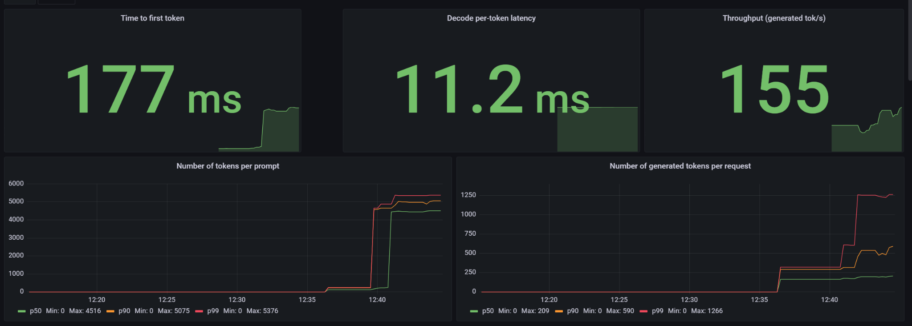
It works: Mixtral 8x7B on 2xH100 NVL using TGI

Slide 34
GB200 - Future successor to both Hopper &Ada Lovelace
https://en.wikipedia.org/wiki/Blackwell_(microarchitecture)
2,5x faster than H100
2x memory
Native support for 4 Bit resolution
Sped up NVLink
https://www.heise.de/news/Nvidias-neue-KI-Chips-Blackwell-GB200-und-schnelles-NVLink-9658475.html

Slide 35
Evaluation

Slide 36


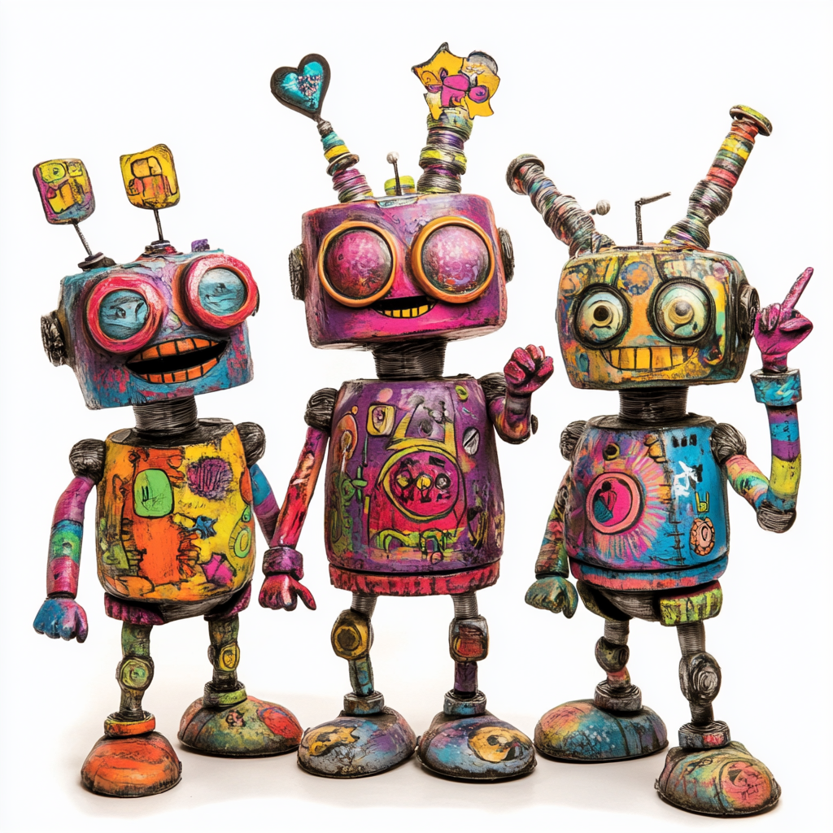
Evaluation on text results
User:
Asking a Question
Question
What is Pluvia ?
Answer
Pluvia is a latin word meaning rainfall.
The latin word for rainfall.
….
=> equality not an option
answer
Human Eval
Llm:
Generating an Answer
Notes:
When you a send a model twice the same question, you may get different answers.
And both maybe correct.
Thus we can’t use equality to compare text answers.
Unit testing, detecting regressions or debugging may get quite painful.
Of course if your model has a categorical output – like in a sentiment analysis – then you’re fine.
Models are update frequently – or they come in different sizes, just like we did with quantisation.
Comparing the impact of different model on our system becomes a real headache.
A good but expensive way is to ask humans to evaluate the answers.
This is great to build up the gut feeling.
But who wants to become a part of a build-pipeline ?

Slide 37
Evaluation on text results
Evaluation Criteria:
Correct
Complete
Concise
Relevant
Contradiction free
Language
Style
…
Generation successful
User:
Asking a Question
answer
Ground Truth
Human Eval
Statistics
Llm:
Generating an Answer
Notes:
On Text answers it is also not so clear of what we want to evaluate.
If your users only speak german, an italian answer even if semantically correct is not acceptable.
You may use statistical values, like the length, or given «a correct» answer how many word matches.
It turns out statistics like these often don’t work very well.
To determine the «correctness» or «completeness» you need a correct answer – a so called ground truths.
However this may be surprisingly difficult.
Many teams start out with humans doing the evaluation. This is actually quite great.
I often do it also myself.
Simply by looking at the answers generated you do get quite a good feeling on how well the system is performing.
However this does not scale, and as a human you don’t want to become a part of a build-pipeline.
The solution here is, to use an llm as a judge.
Meaning send the generated answer with a suitable prompt to an llm and hope that you get the expected evaluation result.
More precisley:

Slide 38
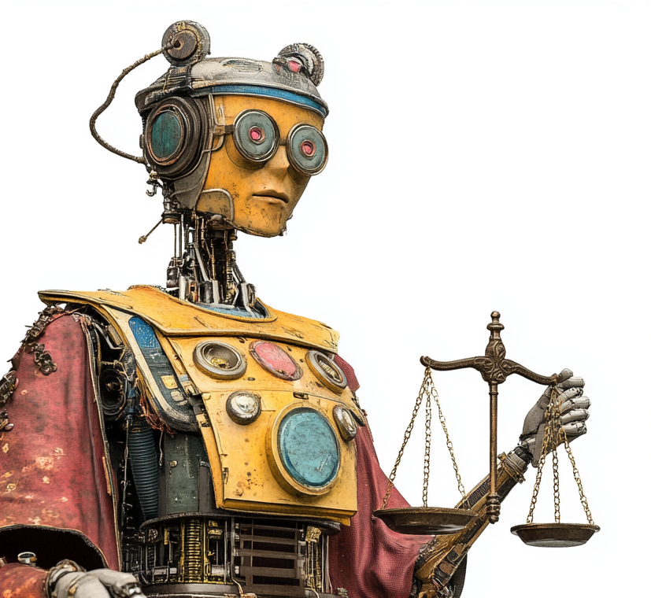
Evaluation on text results
Evaluation Criteria:
Correct
Complete
Concise
Relevant
Contradiction free
Language
Style
…
Generation successful
User:
Asking a Question
answer
LLM as a Judge
Ground Truth
Human Eval
Statistics
Llm:
Generating an Anwer

Slide 39
LLM as a judge: Idea
Generation
Llm Input : “Why do you dislike writing texts ?”
Llm Output : «Witing texts is painful, caus im making mitakes.”
Prompt
You are an expert on english language. Grade a students text with scores between 0 and 10.
Answer with a Json containing a score and a reason.
Student Text: Witing texts is painful, caus im making mitakes.
Json:
Result
{
'score’: 2,
'reason’: "The text contains multiple spelling errors, such as 'Witing' instead of 'Writing.“
}
Notes:
Given the input and output of the last llm call we use a prompt that asks the eval to do the grading.
Besides the prompt, the input & output are of course also included in the context that we send to the model.
In the prompt we also ask for a json containing a score between 0 and 10 and a reason for the score.

Slide 40
LLM as a judge: G-Eval
G-Eval Arguments
Eval Criteria : «Grade the english grammar and syntax»
Llm Input : “Why don’t you write longer texts ?”
Llm Output : «Witing texts is painful, caus im making mitakes.”
G-Eval Steps
From the Criteria generate an outline of the eval steps
Build a prompt using the generated steps, Llm input & output to produce the score & reason
Evaluate the prompt from step 2
G-Eval Result
{
'score’: 2,
'reason’: "The text contains multiple spelling errors, such as 'Witing' instead of 'Writing', 'caus' instead of
'because', and'mitakes' instead of'mistakes'. Additionally, the text is written in a non-standard
dialect of English, which affects its clarity and coherence.“
}
https://arxiv.org/abs/2303.16634

Slide 41
Demo: Evaluation on Prem Notebook

Slide 42
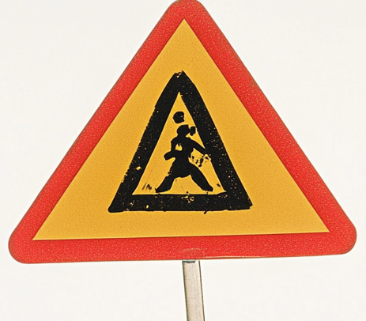



System Architecture
User:
Asking a Question
Doc Loader:
Image2Text
chunks
question
Anonymizer:
Enforcing Privacy
chunks
answer
SystemPrompt
Question
Chunks
chunks
Llm:
Generating an Answer
Vector DB:
Searching facts matching
the question
Notes:
so far we sent the user input directly to the llm.
A typical system architecture looks more like this.
The question is first sent to a so called vector database containing all documents.
Here we search for pages, paragraphs or other text fragments that match the question.
We add them to the input context along with the original question and instructions.
The quality of the answer thus directly depends on the quality of the added text fragments.
To load the database we start with a pile of pdfs.
Here we may need another model taking care of ocr or image recognition to turn the pdfs into text.
If you are in a very privacy sensitive are – like olli in an insurance - we must remove all person-identifying-information,
Like names, social security numbers, adresses and so on. For this you may need yet another model.
The vector database itself is based on yet another model to do the semantic matching between question and document fragments.
All in all there are many different modles collaborating.
To ensure privacy all of them must run on prem.
Building a prototypical system that works «somehow» is one thing,
Building a system that can be operated & maintained over time is a very different story.
Even a small change or update in any of models may have a strong impact on the systems answer quality.
To avoid regressions we must at least be able to evaluate the answers created.
This may be surprisingly difficulty.

Slide 43
System Architecture: Evaluation
User:
Asking a Question
Doc Loader:
Image2Text
chunks
question
Answer Relevance
Conciseness
chunks
Contextual Relevance
Anonymizer:
Enforcing Privacy
answer
SystemPrompt
Question
Chunks
chunks
Llm:
Generating an Anwer
Vector DB:
Searching facts matching
the question
Faithfulness
Notes:
Since all models belonging to our system may have a strong impact, we not only evaluate the generated answer, but also the
Chunks or text fragments provided by the vector db.
Hence we can check if the content of generated answer is actually grounded by the information contained in our documents.
Or we can track if the database produces results that are relevant for the users question.
Having all these evaluations available makes it much easier to discover, why a system does not work as expected.
Moreover we can run these evaluations online, yielding a continuous monitoring of the involved llms.

Slide 44
Demo: Online Eval in ProPlanner

Slide 45
Evaluation Issues
Online Performance impact on LLM
Eval may call 10x more often, but have less output tokens
Which LLM do you use ? Same ? Faster ? Most Powerful ?
What Dimensions do you eval ?
Toxicity, Conciseness, Answer Relevance ?
Ground Truth available ?
Human Feedback from your users ?
Interpretation of the Scores ?

Slide 46
Your Experience ?
Anyone already on Prem ?
Anyone doing RAG ? In Production ?
Do you do evaluation ? By humans ?
What else do you use for evaluation ?

Slide 47
Eval Frameworks
DeepEval https://docs.confident-ai.com/
Ragas https://ragas.io/
TruLens https://www.trulens.org/
Evidently https://www.evidentlyai.com/
Ares https://ares-ai.vercel.app/
…

Slide 48
Wrap Up

Slide 49
Key takeaways

Slide 50
Collection of notebooks used
Quantization:
https://colab.research.google.com/github/DJCordhose/practical-llm/blob/main/Assessment.ipynb
Evaluation:
https://colab.research.google.com/github/DJCordhose/practical-llm/blob/main/Eval4pptx.ipynb

Slide 51

Thank you

Slide 53
Collection of notebooks used
SetFit: https://colab.research.google.com/github/DJCordhose/practical-llm/blob/main/Assessment_SetFit.ipynb
Microsoft Phi 3 3.8B: https://colab.research.google.com/github/DJCordhose/practical-llm/blob/main/Assessment_Phi_3_mini_T4.ipynb
Google Gemma 2 2B: https://colab.research.google.com/github/DJCordhose/practical-llm/blob/main/Assessment_Gemma_2_2B_T4.ipynb
Meta Llama 3.1 8B - Quantized to 4-Bit and 8-Bit: https://colab.research.google.com/github/DJCordhose/practical-llm/blob/main/Assessment_Llama_3.1_8B_Quantize_T4.ipynb
Meta Llama 3.1 8B: https://colab.research.google.com/github/DJCordhose/practical-llm/blob/main/Assessment_Llama_3.1_8B_Full_T4.ipynb
Mixtral 8x7B with extreme quantization: https://github.com/DJCordhose/practical-llm/blob/main/Assessment_Mixtral_8x7B.ipynb

Slide 54
LLM Drift Detection
score changes a lot
accuracy or
a criteria
distribution changes a lot, e.g.
length of inputs or outputs
processing time / latency
use univariate two-sample tests
choose test based on properties of samples
train an Encoder Model to tell old data from new data
if the model has predictive power, there must be a systematic change
https://www.evidentlyai.com/blog/data-drift-detection-large-datasets
https://www.evidentlyai.com/blog/open-source-llm-evaluation#drift-detection

Slide 55
Finding Drift in Embeddings
Embedding can be generated from text using encoder style embedding model
Can be as simple as raw encoder model without head
https://openai.com/index/new-embedding-models-and-api-updates/
drift detection methods (potentially with dimensionality reduction)
Euclidean distance on average embedding
Cosine distance on average embedding
Classifier model
Share of drifted embedding components
https://www.evidentlyai.com/blog/embedding-drift-detection
Failing Loudly: An Empirical Study of Methods for Detecting Dataset Shift: https://arxiv.org/abs/1810.11953

